Slide 1
CAPSTONE PROJECT
PHO ONG HUNG

Slide 2
I. Introduction
Problem background :
Pho, a World Famous Vietnamese Cuisine Phenomenon! In 2011, along with Banh My, Pho was added to Oxford Dictionary as a representative of Vietnamese cuisine. For people who didn't know about Pho, it is a Vietnamese soup that is normally made with a bone-beef broth, Banh pho noodles, and thinly sliced beef, that's often served with bean sprouts and other fresh herbs on the side. Not to be confused with Japanese ramen, which is usually made with wheat noodles, Pho is made with rice noodles.

Slide 3
I. Introduce
Problem description:
Pho Ong Hung is one of the most famous brand in Vietnam. Now, the brand has a plan to expand its business in Toronto. The first job is finding the most suitable place for its.

Slide 4
II. Data
We decided to use regularly spaced grid of locations, centered on city center, to define our neighborhoods.
Following data sources will be needed to extract/generate the required information:
centers of candidate areas will be generated algorithmically and approximate addresses of centers of those areas will be obtained using Google Maps API reverse geocoding
number of restaurants and their type and location in every neighborhood will be obtained using foursquare API
coordinate of Toronto center will be obtained using Google Maps API geocoding of well-known Toronto location

Slide 5
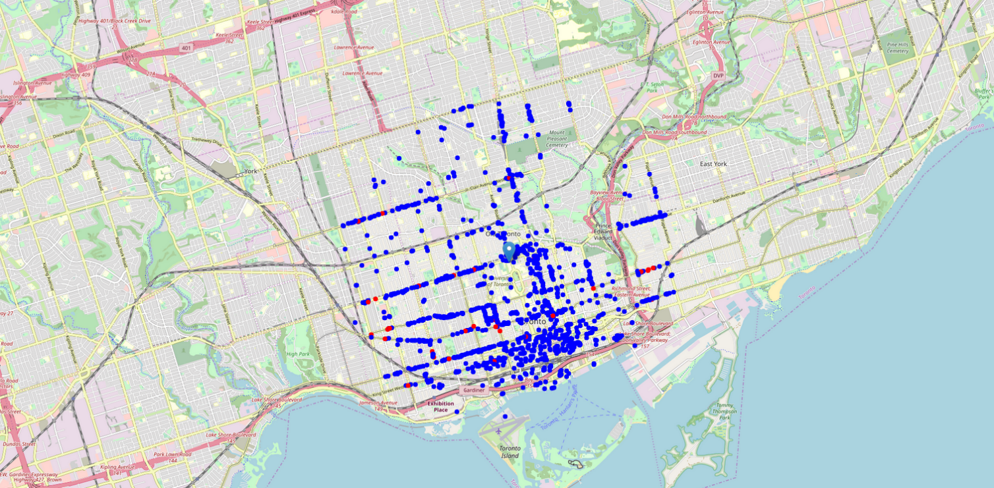
III. Explore
Toronto map

Slide 6
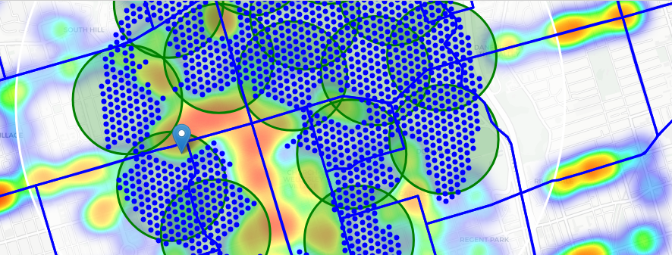
IV. Cluster Neighborhoods

